Slide 1
Data 3950 – Machine Learning
Note: We’ll start classes at :05 to give people a sec to login and get setup.

Slide 2
Overview
Introduction and logistics.
Course overview.
ML review of stuff from stats.
Part 1 of assignment #1.

Slide 3
Instructor
Akeem Semper
Contact: asemper@nait.ca
Education:
B.Sc. Computer Science
B.Ed. Secondary Math/Physics
MBA
Relevant background: Mainly in reporting analytics.

Slide 4
Overview
Broad coverage of major machine learning techniques – 2m ‘classical’ models, 1m neural networks.
Focus on being able to apply the techniques in code.
Explore, but not deeply interrogate, the mathematical backing and theory.
Survey impacts and uses of different technologies.
For each ”chunk”, we’ll aim to cover:
An algorithm (or two).
A type of data.
Some tools/library/processes.
Goals by the end of the course:
For simple/repeated problems, you can solve them by building models.
For more complex/novel problems, you have an idea what to start investigating.

Slide 5
Grading
Quizzes: 15%
Assignments: 50%
Projects: 35%

Slide 6
Quizzes
The quizzes will be relatively minor, not full midterms.
The focus is primarily on doing, so we’ll focus on making stuff.
Open book.
Quiz 1:
Classical machine learning concepts.
Quiz 2:
Neural network/deep learning concepts.
Business societal impacts (depending on timing)

Slide 7
Assignments
Assessed on:
Accuracy.
Coding.
Specific measures of the topics we’re covering.
Assignment topics:
Simple classification and pipelines.
Regression and data cleaning.
Unsupervised learning and generative models.
Basic neural networks.

Slide 8
Projects
Groups of 2 - 3.
Larger and more complex.
Topics:
Natural language processing and text classification.
Image recognition with neural networks.

Slide 9
Progression

Slide 10
Resources
(Almost) Everything is free!
Three textbooks are on Brightspace:
Introduction to Machine Learning – full textbook on pre-NN machine learning.
Python Data Science Handbook – short summary on pre-NN machine learning.
Deep Learning with Pytorch– full textbook on neural networks (we’ll only cover part).
Another good book -
Tools:
GitHub, Anaconda, VS Code – the same infrastructure as last semester.
Colab (or other GPU) for the final ~month. Colab will cost about $15 for a month.

Slide 11
Other resources
This stuff is very, very well documented in many places.
If you need/want a different look at something, it is out there.
Recommended:
Look to documentation.
Check to see if it is covered in book.

Slide 12
Tips and Rules
Very “learn-by-doing” topic – trying things is far more important than listening/reading.
Be honest about progress, what makes sense, what’s hard, etc…
The goal is to get you all to be novice data scientists, needed time on topics will vary.
Bring relevant examples, if they occur:
E.g. if the project class requires you do some specific thing, let me know so I can make examples that are relevant to that. We’ll do geographic stuff because of this later.
Experiment – try to change things and see what happens!
Read, don’t memorize.
If you get used to reading documentation, and applying that, you’ll be able to code anything.

Slide 13
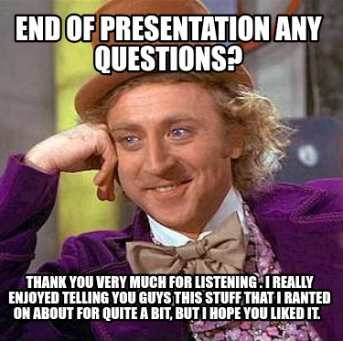
Questions

Slide 14
WHAT’S MACHINE LEARNING?
What if I want to know…

Slide 16
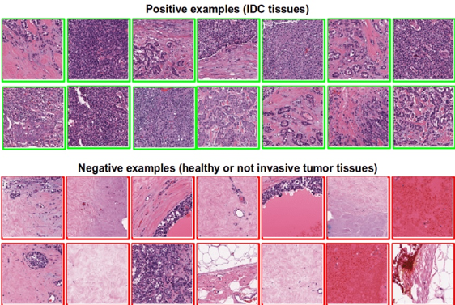
Is this Cancer?

Slide 17
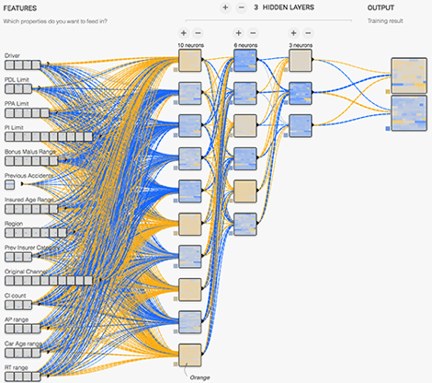
How Risky is this driver?

Slide 18
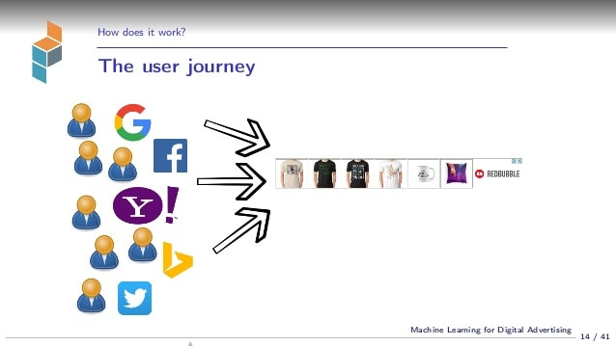
Who’s Going to Buy My Product?

Slide 19
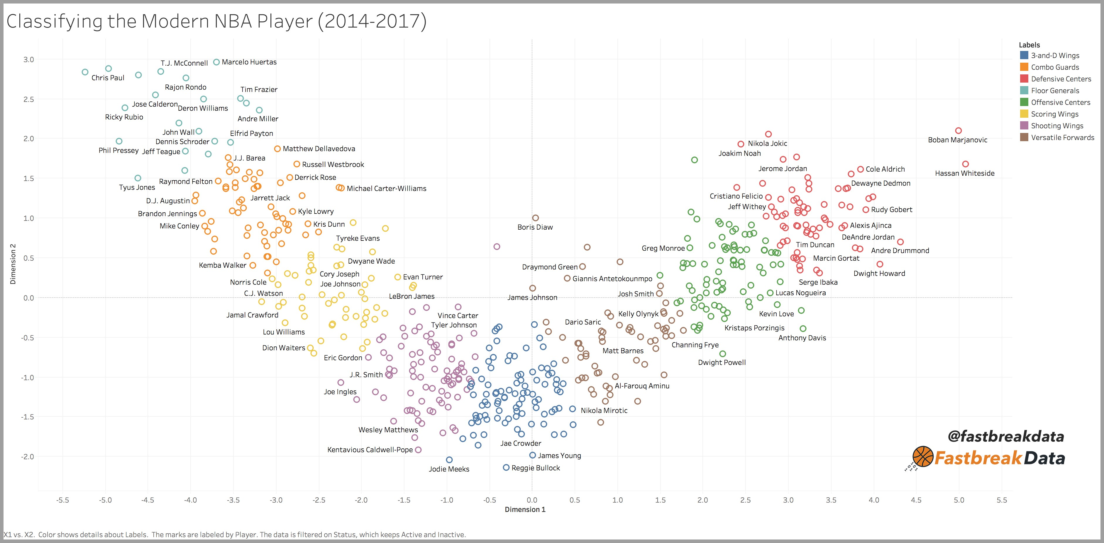
Is this Player Going to Excel in the NBA?

Slide 20
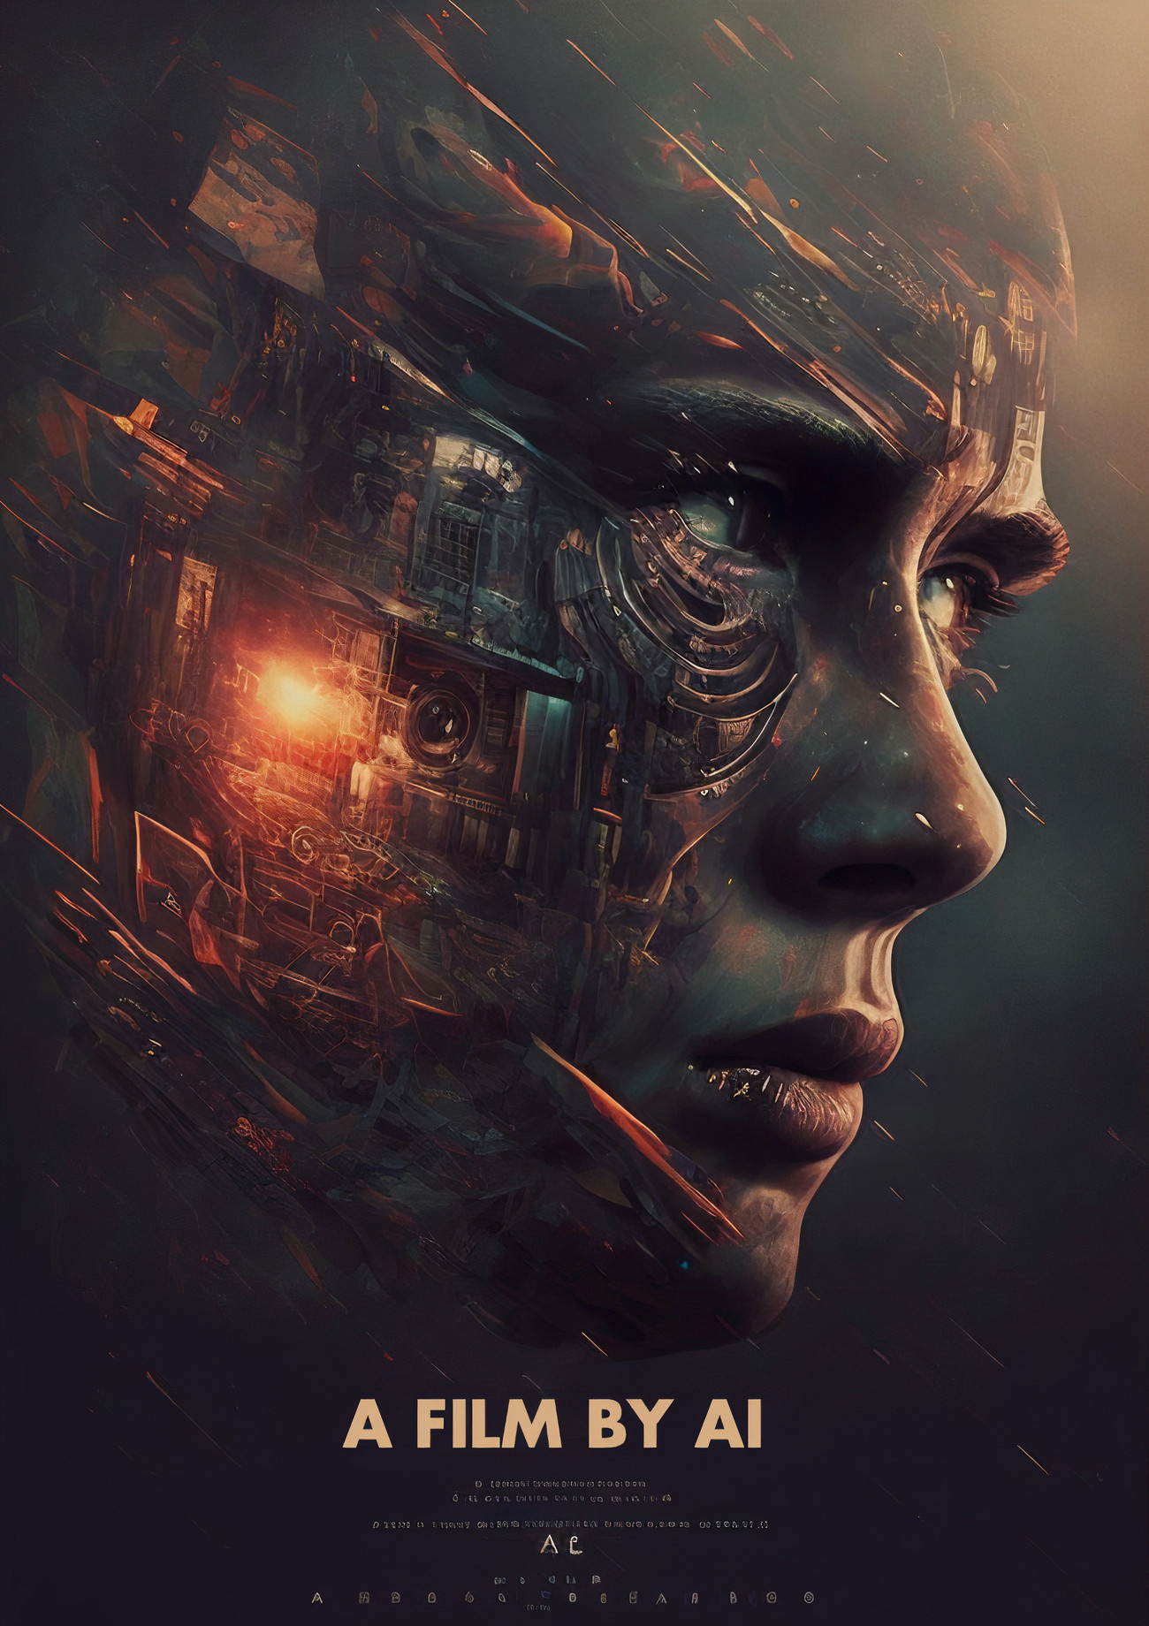
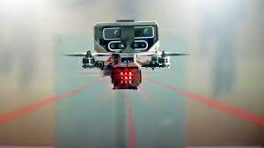
More Relevantly in the modern age…
It can also allow people to destroy the concept of human creativity, generate child porn on Twitter, or create an army of AI powered killing machines.

Slide 21
MACHINE LEARNING BASICS
Computerized information systems allow us to capture massive amounts of data.
Machine learning is using computers to detect patterns and use those patterns to make predictions.
Basically – if we have a lot of old examples, the computer can become really good at learning patterns and making predictions.

Slide 22
Machine learning is everywhere!
Making predictions is a common and useful thing, so we see ML applied all over the place.
Finance – loan approval, risk evaluation, algorithmic trading, anomaly detection…
Marketing – customer analysis, segmentation, profiling….
Logistics – demand forecast, stock management…
Destroying the world – AI based targeting, automated killbots, gambling on news…
Science – drug discovery, predicting reactions, automated diagnosis, sports injury preds…
Random stuff – translation, image recognition, traffic estimates…
Anywhere that we have relevant data, we can use machine learning.
Many/most things have data, and the amount increases constantly.

Slide 23
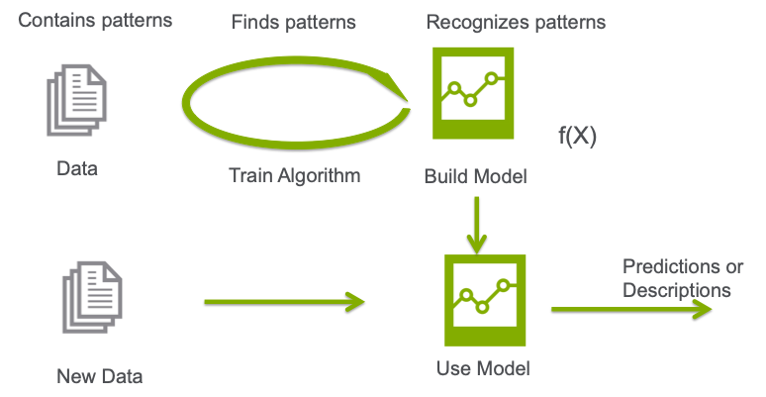
What’s the Key?
Don’t tell computer how to make predictions.
We give the computer old examples, it figures out how to make predictions itself.
E.g. to recognize an image of a person.
Give computer many ‘people’ images and ‘not people’ images as training.
Machine learns what differentiates them based on input (pixels here).
Our job is mainly to steer data and manage the process.

Slide 24
Old Concepts, New Applications
That idea isn’t new:
How do you predict if a restaurant will be good?
If a job is worth applying for?
If someone will date you?
The scale, breadth, speed, and accuracy are new.
More data and smarter models means that more subtle patters can be found.
We can apply this almost anywhere that we have data.

Slide 25
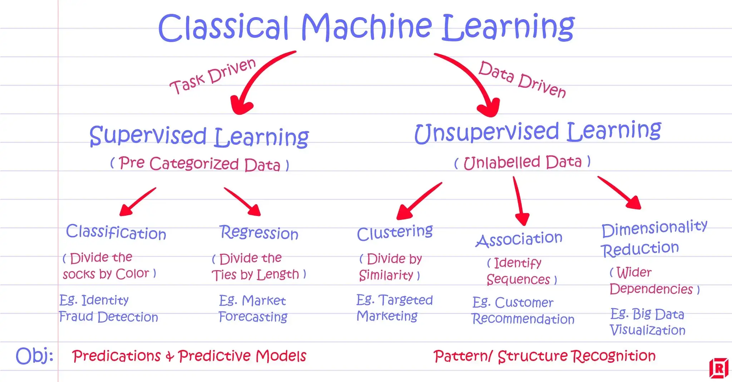

Slide 26


Slide 27
What’s this Deep Learning Bit?
Deep Learning uses neural networks – one type of algorithm of machine learning.
The DL algorithm is equivalent to regression, trees, etc...
The concepts are the same (mostly), the scale and complexity is higher.
Neural networks are very good with unstructured data – images, language, etc…
(Virtually??) All of the cool AI things are based on deep learning models.
Image recognition.
Large language models.
Image and video generation.
Deep learning models can be very powerful, but need lots of data to train.

Slide 28
Do we Remember the Details?

Slide 29
The ML Process is Simple
The machine learning process will always involve a few basic steps:
1 – Collect data on what we care about.
2 – ‘Clean’ that data up.
3 – Give the data to the algorithm to learn.
4 – Evaluate and revise if needed.
5 – Let the model generated from the algorithm make new predictions.
Our work here is generally in stages 2 to 4.
There are many different models that will work, we need to try to find a good one.

Slide 30
Stuff you should be OK with
Manipulating data.
Dataframes, arrays, etc…
Data types
Basic stats.
Range, variance, count, et…
Correlation and R2.
Distributions and visualization.
Model basics.
Target, features, train/test, etc…
SKLearn pipelines.
Load data, add steps, fit model, interpret.
Classification and regression.
Error/loss metrics for each.
Regression models.
LLS and gradient descent concepts.
Transformations.

Slide 31
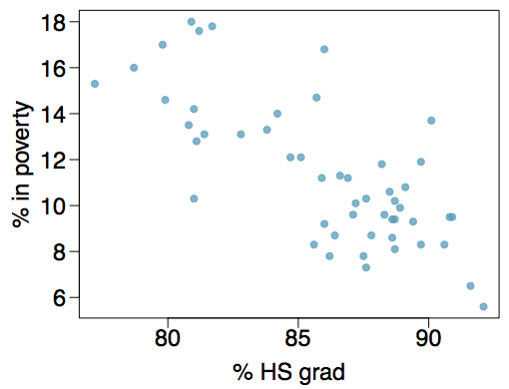
Review – Regression and Gradient Descent
Model – slope and intercept with y=mx+b.
Can predict Y given X.
These are the parameters/weights, what the model learns.
How to determine m and b?
LLS – calculate directly with simple data.
Gradient descent – iterative process (fit/train).
Gradient descent process:
Make a guess for the parameters.
Measure amount of error (w/ some calculus).
Adjust parms to lower error, repeat.

Slide 32
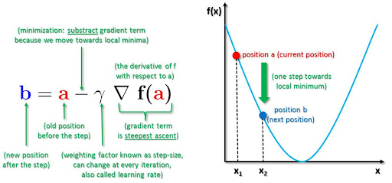

Slide 33
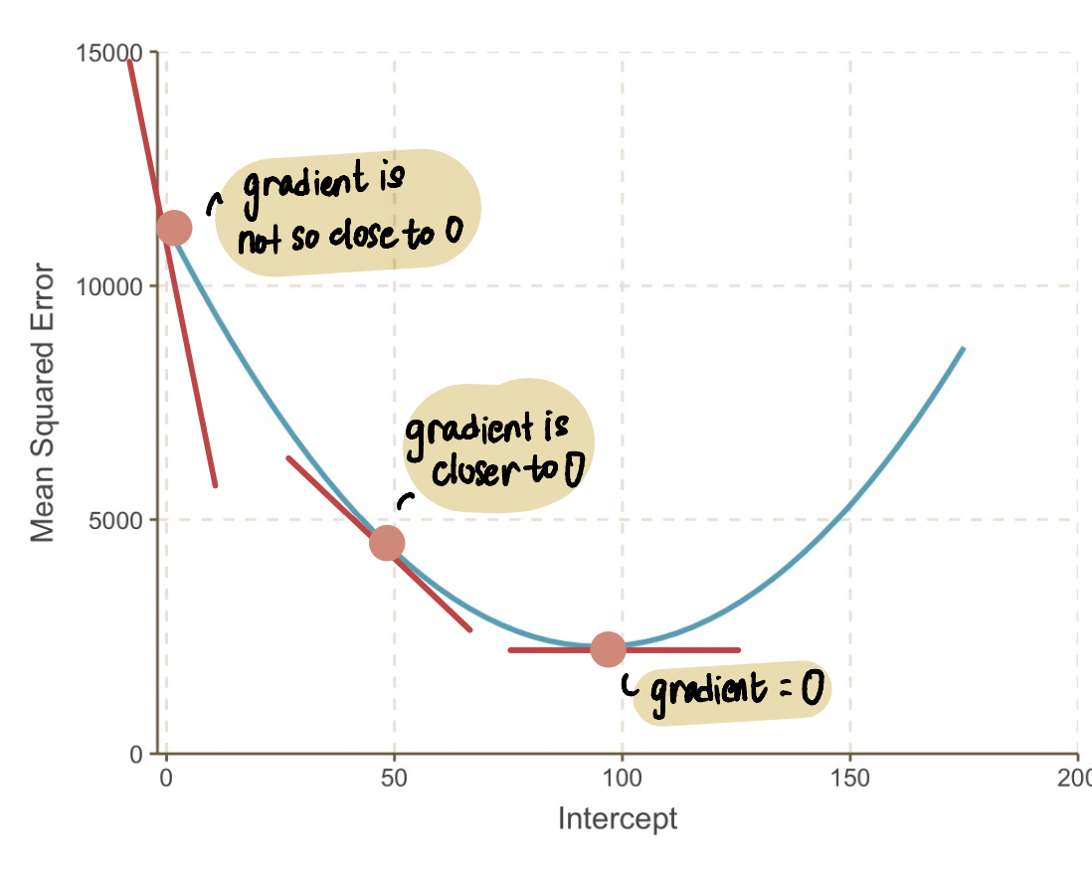
Make your Grades Descend!
Gradient descent isn’t universal, but it is quite common.
Every model has some equivalent step to calculate the parameters.
This is what fit() does.
This can be slow in real usage.
If we know params, we can predict.
Model generates Y from X.
The training process creates ‘the rest’.
E.g. find m+b, combine w/ equation.

Slide 34
Coming up…
That basic framework will mostly stay in place no matter what we are predicting.
We’ll add:
More types of models, that work better in different scenarios, and their theory.
More data preparation, to handle data like images, language, etc…
More data ‘cleaning’ in the pipeline, to get data modelling ready with different types of data.
Some of the unsupervised learning stuff will popup here.
Ways to make models more accurate and reliable.
Use the deeper understanding to make smarter decisions along the way.
Later, we’ll repeat with NN (pytorch) – concept is the same, tools get very different.
Still predicting target given features, but larger scale and more complex models.

